Slide 1
Viral Activism
Hashtag Creation
Your Task: Create an original hashtag that links to a controversial issue that you feel passionate about. This can be a world-wide issue, a community issue or even an issue that is current within your school.
Criteria:
One powerpoint slide
Slide should contain:
Your original hashtag, bold and strategically placed for easy visability.
Image(s) or collage that appropriately match your hashtag and serve a strategic purpose in the meaning of the hashtag
Textboxes with a detailed explanation of the hashtag – what does it stand for? What is its purpose? Who will be its audience? What goals does it want to accomplish?
A MODEL IS PROVIDED FOR YOU.
INSERT A BLANK SLIDE AT THE END FOR YOUR ORIGINAL CREATION

Slide 2
Some Ideas for Possible Topics
Here are some categories with “hot topics” in our society
You can definitely think of your own or “piggy back” on one of these
Education College Ed School uniforms Standardized testing Tablets vs. Textbooks Using devices in classrooms | Politics Driving Age Drinking Age Death Penalty Drones in business | Science/Tech Alternative Energy Animal Testing Cell Phones Social Media Video Games and violence Television and….. Genetically modified food | Health Euthanasia Obesity Vaccines for kids Other??? | Religion Pledges in school Issues in church Holiday celebrations

Slide 3
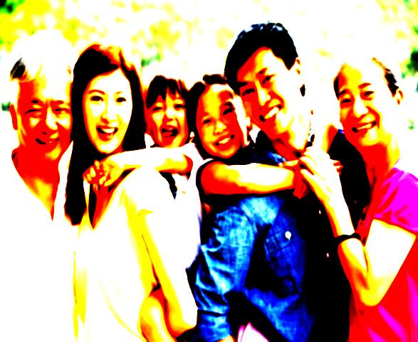
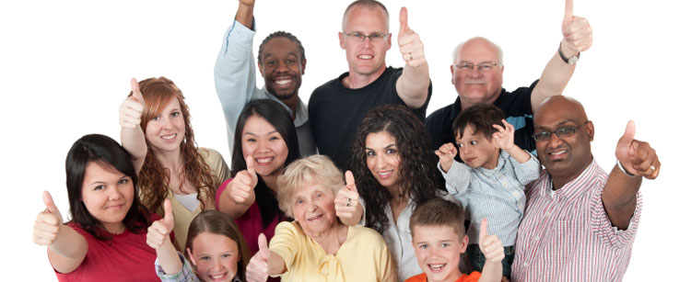
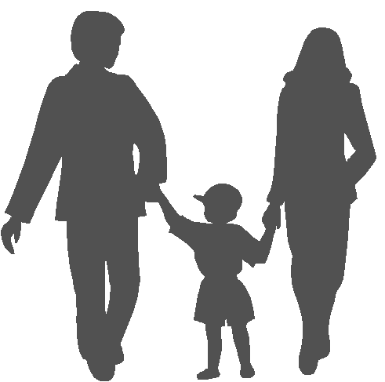
TheyreTheOne
What does this stand for? Theyretheone stands for parents – two parents who basically mesh into one person when bringing up children. I firmly believe that two parents are necessary and ideal and together they make “one”. They (the parents) are the ONES who make a difference, who need to work together as a team, who are
the vital link to the healthy
development of a child.
Audience of any age
GOAL: Awareness and Discussion of what a true family is
What’s the concern? This hashtag is referring to the importance of two parents being a team in the upbringing of children. The concern to me is the fact that in our society, families are more and more
breaking apart. There are single mothers and single fathers taking care and bringing up the children. There are grandparents that are given the responsibility of bringing up children when the parents are not capable or otherwise (in jail, had babies too young, or simply abandoned the child). This has created huge problems in our society as children are missing out more and more on true moral values in relationships.

